Slide 1

Making a Normalization method file for Hamilton Star

Slide 2
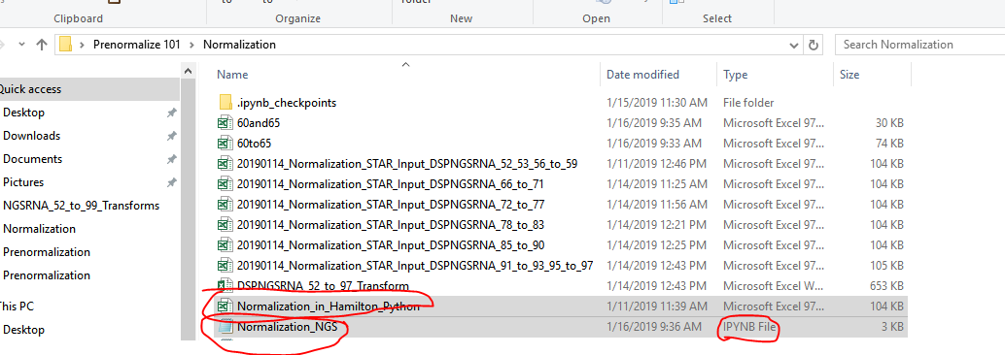
1. Make sure the required files are in the folder path
Two required files are needed for the Python script to run
The Hamilton Normalization method input file
The python script

Slide 3
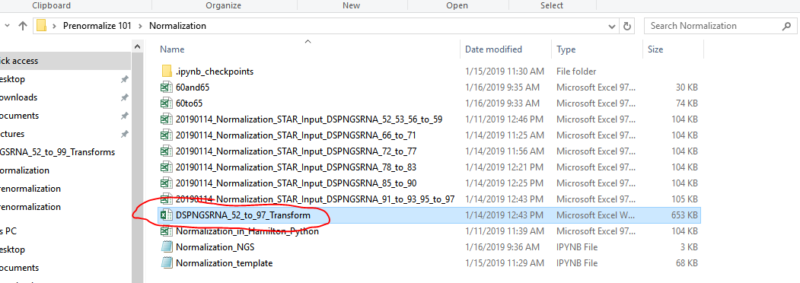
2. Add the transform file into the folder path

Slide 4
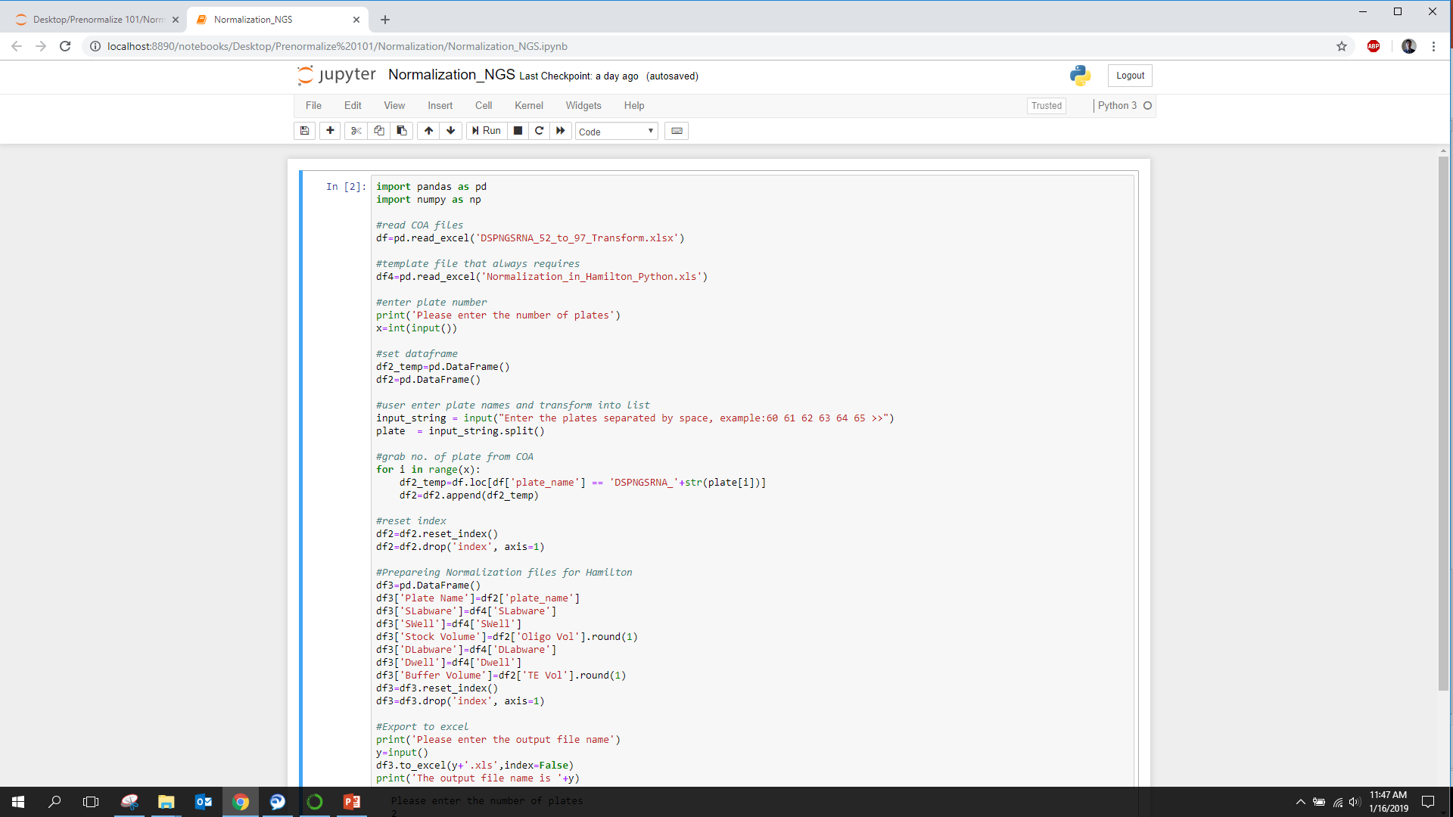
3. Launch Jupyter and open then the python script

Slide 5
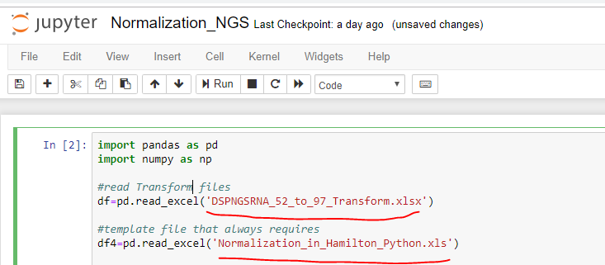
4. Make sure the name of the Transform file and template file matches the one in the folder path
* If not, please change the name of the files on the script

Slide 6
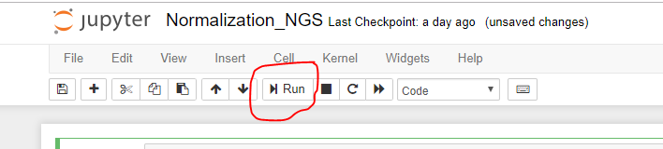
5. Click run or ‘Ctrl + Enter’ to run the script

Slide 7
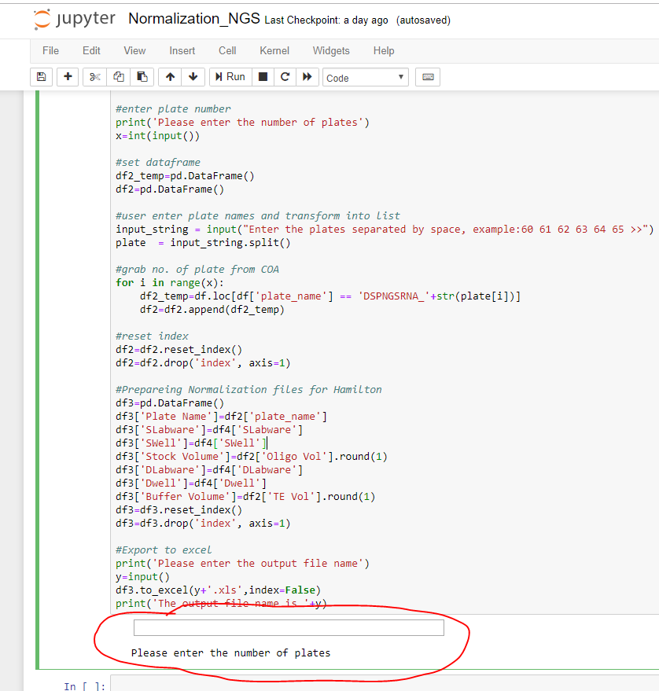
6. Enter the number of plates into the following box ( min: 1, max: 6)

Slide 8
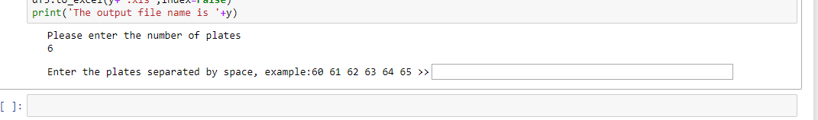
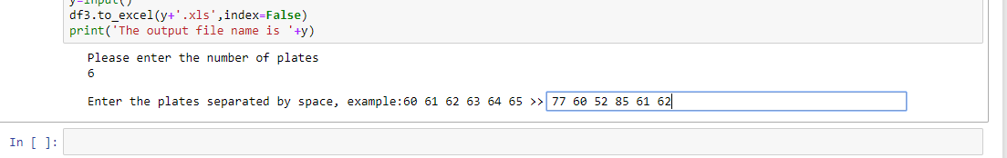
7. Enter the name of the plates separated by space into the box(it can be in any order)
However, it has to match up to the number of plates entered earlier

Slide 9
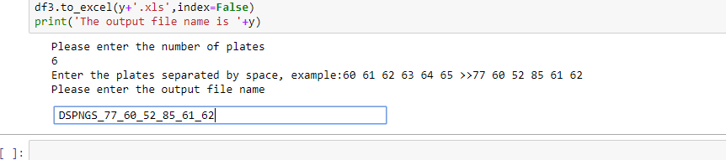
8. Enter your output file name

Slide 10
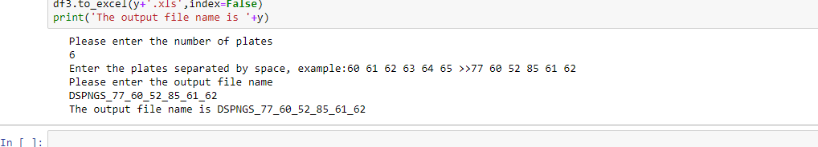
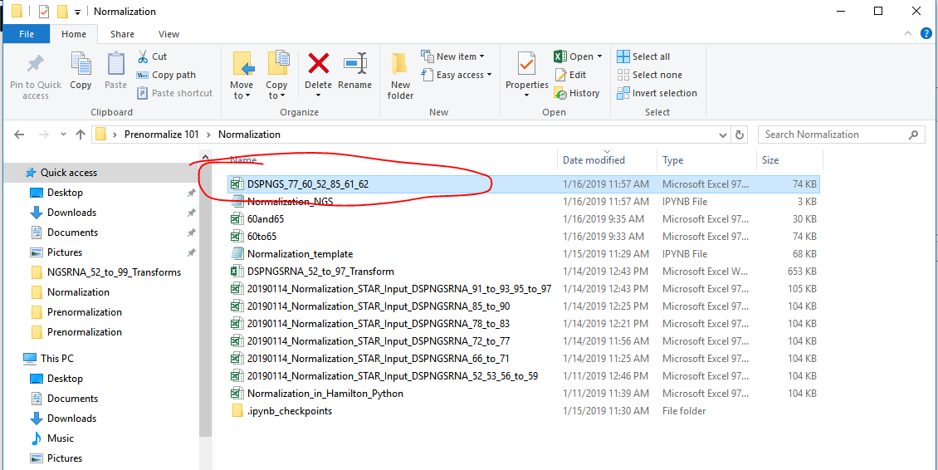
9. Hit ‘Enter’ and the file should be generated in the specific folder path

